Slide 1

Web Application Frameworks (WAFs) &
Yuval Dolev

Slide 2
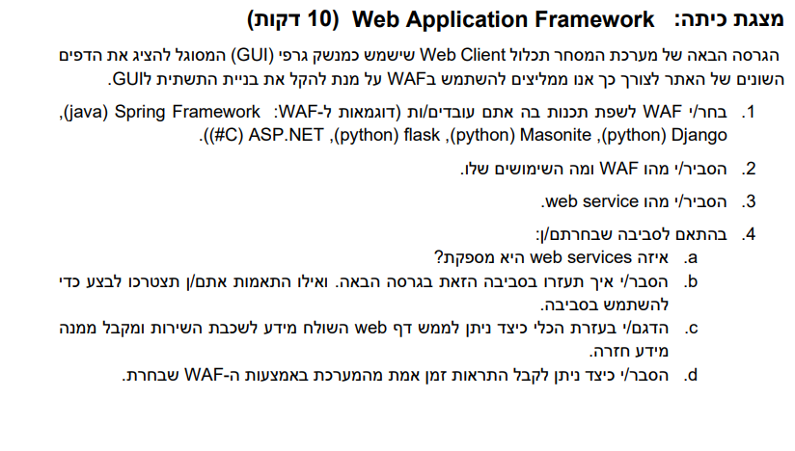

Slide 3
What are WAFs

Slide 4


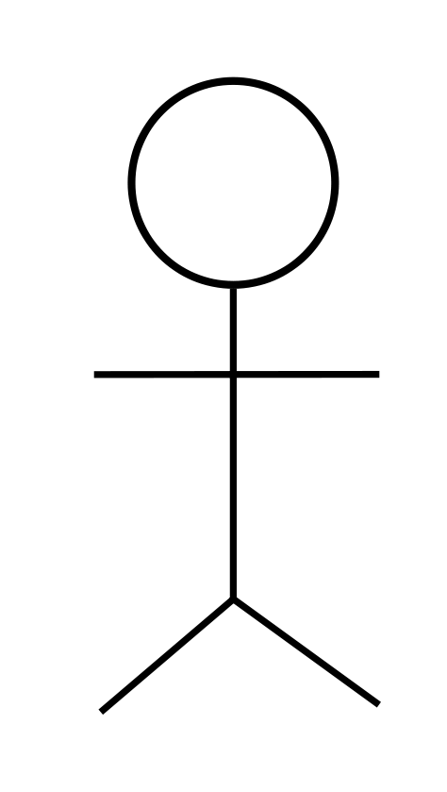
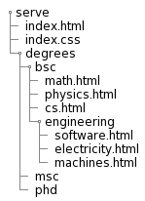
Static websites
File system
click
UI
href=“…”
code
GET /degrees/bsc/math.html
photons?
UI layout
<html>…
Notes:
Mostly a directory that everyone has read access to.

Slide 5
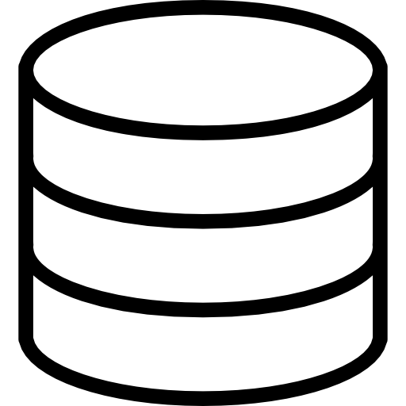
Web apps
[oversimplied, pre-SPA internetting]
click
UI
onClick()
code
request processing
controller
Business logic
DAL
POST /forum …
create()
create()
create()
SQL
View renderer
photons?
UI layout
<html>…
ForumCreated
OK
forum_created.html
1 row affected

Slide 6

Web apps + auth
[oversimplied, pre-SPA internetting]
storage
session table
request.session
session.user
click
UI
onClick()
code
request processing
controller
Business logic
DAL
POST /forum …
+
create()
create()
create()
SQL
View renderer
photons?
UI layout
<html>…
+
ForumCreated()
OK
forum_created.html
1 row affected

Slide 7




The full stack
Front-end
Back-end
UI & interactions
Databases
Request processing
Session management
Authentication & security
Business logic
API
Third-party integrations & API calls
Server management

Slide 8
Web Application frameworks
N-tier architecture
Request processing
Cookie & session management
View rendering
Authentication
DAL with ORM
More?

Slide 9
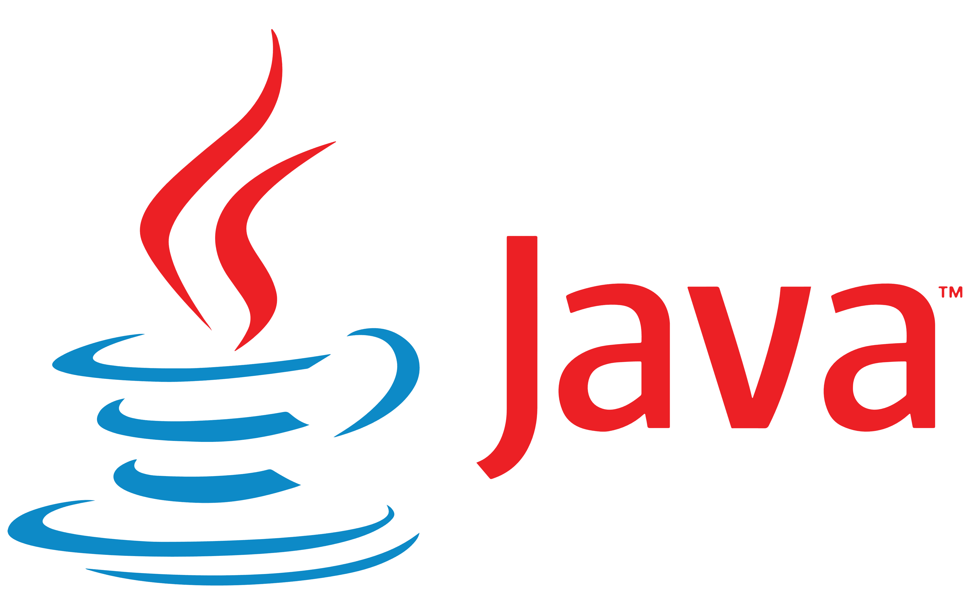
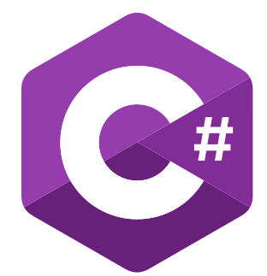










Some WAFs

Slide 10
Web services

Slide 11
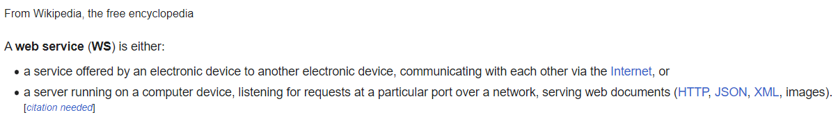
Web Services
שרת אינטרנט (או על רשת שאינה בהכרח האינטרנט) שמספק שירות ללקוחות דרך משאבים, למשל משאבי XML, JSON, דפי HTML עם CSS ו-JS, תמונות, קבצים וכו'.

Slide 12
Web Service vs. Web Application
אין הסכמה אוניברסלית על המונחים האלה.
תשובות אפשריות:
Web Application הוא full-stack ומספק ממשק ויזואלי, בעוד Web Service הוא backend בלבד ו/או רק API
Web Application הוא סוג ספציפי של Web Service שהוא full-stack ומספק גם ממשק ויזואלי
אין הבדל?

Slide 13
Our choice - Flask

Slide 14

advantages
Python
Feature rich
Rich standard library
Hopefully simple
Object-oriented: supported but not mandatory

Slide 15
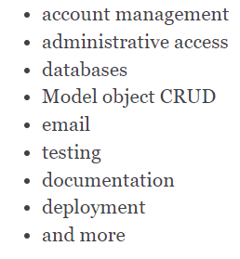
Flask comes with / easily integrates with

Slide 16
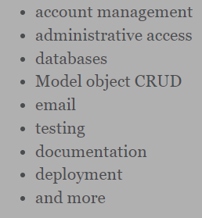

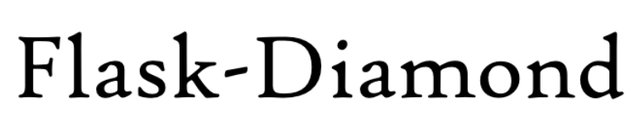
Flask comes with / easily integrates with
(This is actually just a screenshot from Flask-Diamond, which is “a batteries-included Python Flask framework, sort of like Django but radically decomposable”.

Slide 17
SPA – The modern trend
And should you use it

Slide 18
Modern trend: SPA (Single Page Application)
SPA | Pre-SPA Internetting
User asks for an address The user is sent some minimal HTML and, mostly, JS code that the browser executes. The JS code creates the view From now on, every request to the server returns only raw data (usually JSON) instead of a view. The JS code on the browser knows what to do with this raw data and how to render different views. | User asks for an address The request is processed An HTML file is rendered, tailored for the client The response in the HTML page The browser displays the page from scratch The user clicks something The browser redirects to another address Back to the start…
In short: The server sends you code which your browser uses to render views Further requests other than the initial one get only raw data and the client handles that | In short: The server renders views for you This loops happens every time you navigate.

Slide 19





Popular SPA frameworks
Other languages?
Rust, maybe?

Slide 20

SPA: pros and cons
Cons | Pros
Javascript | Trending
 | (Probably) less bytes sent by browsers (JSON vs HTML page)
 | UX

Slide 21
Flask demonstration

Slide 22
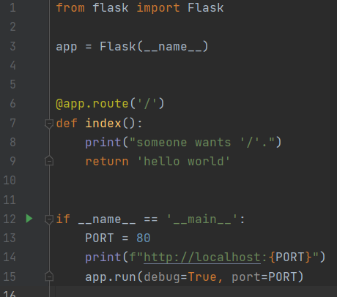
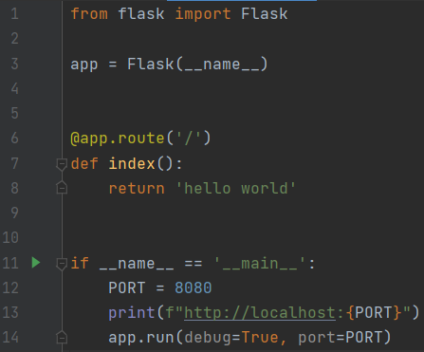
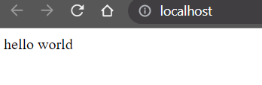
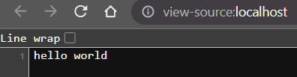
Starting with Flask

Slide 23
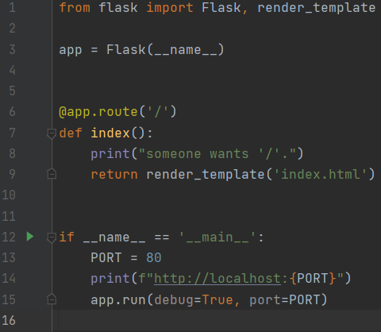
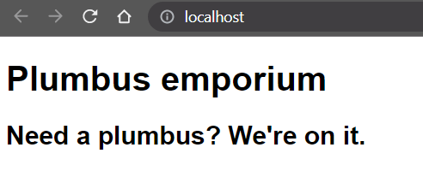
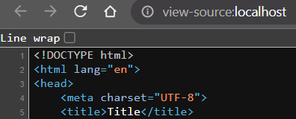
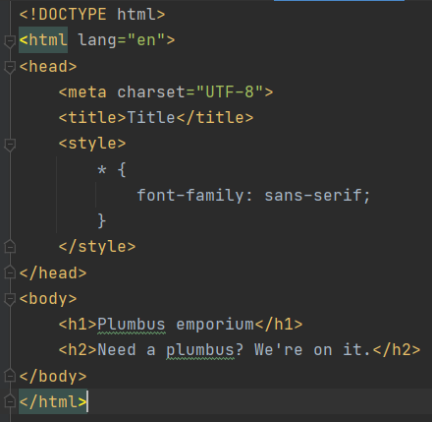
HTML instead plain text

Slide 24
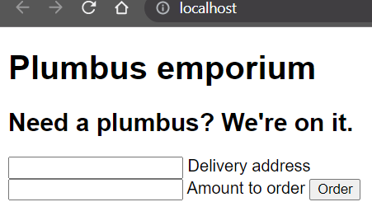
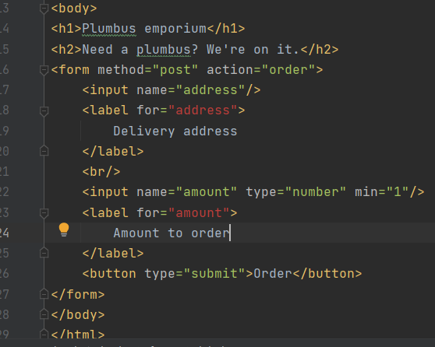
Creating a form

Slide 25
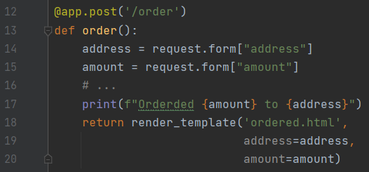
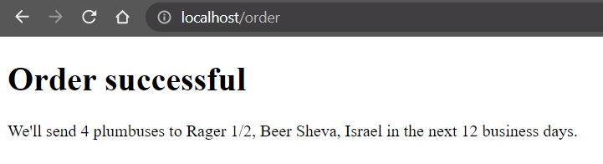
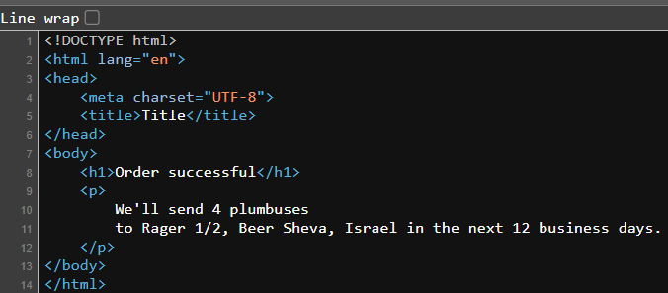
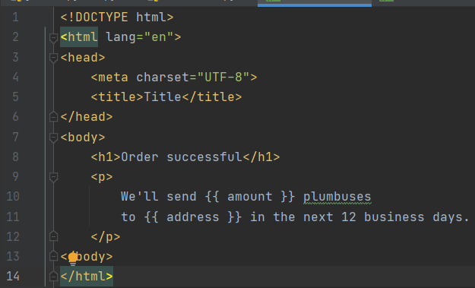
Handling the request

Slide 26
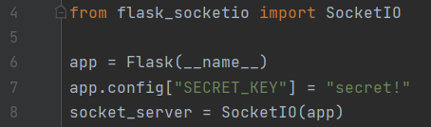
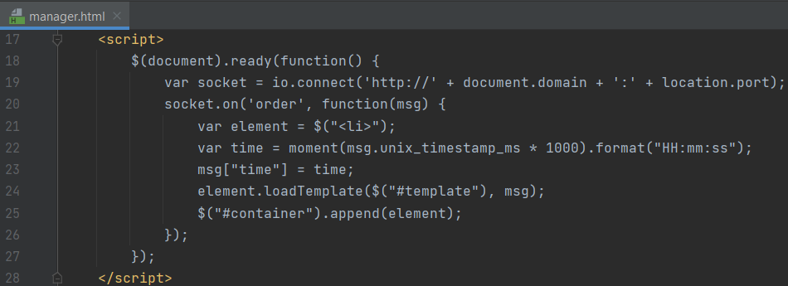
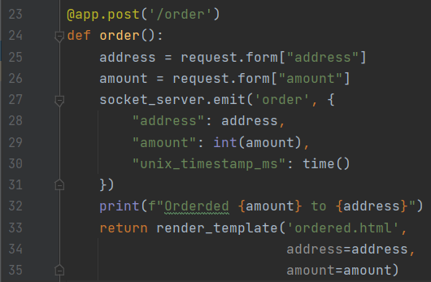
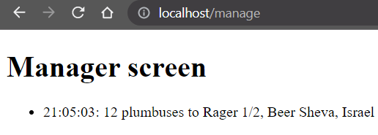
Using web sockets for updates from the server

